Slide 1
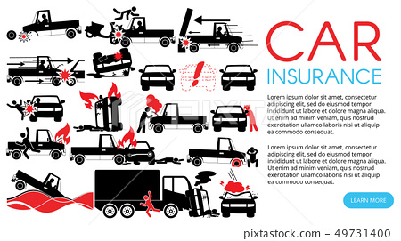

Problem Solving Guidance for Northrop Grumman Suppliers
2025 version

Slide 2
Problem Solving
Effective problem solving is about asking the right questions & answering them well. It is not about filling out a Template-the 8D method we ask you to use is less about a template and more about how to deal with a problem in a standard, logical way.
Solving problems well is in your interest and ours—neither of us wants to deal with recurring problems.

Slide 3
What are we looking for?
We (NG) has experienced a problem… we don’t want to experience it again. Your response (8D) shows us how you have solved the problem. We will probably look over it carefully and have some questions—we share an interest in having confidence in your solution!
Here are some tips:
We might not know your company’s jargon—please think about us as you write (acronyms should be defined or avoided)
A picture is worth a thousand words
Logic Logic Logic—as you go through problem solving, each step should clearly build on the previous steps.
Corrective Actions, for example, shouldn’t appear out of nowhere. They should clearly address a Root Cause (and that Root Cause should clearly address the Issue at hand as defined by your Failure Analysis)
Process Process Process—all work is done in processes. If you don’t address process weaknesses with Corrective Actions, we will probably be experiencing the same problem again in the future.

Slide 4
What are the NGC 8D’s?
Below are the 8 “Disciplines” of the 8D framework. The 8D “method” was popularized by Ford in 1987 as TOPS (Team Oriented Problem Solving). With roots in MIL-STD-1520C, it has been widely adopted across many industries and business sectors.
D1: Form a team
D2: Describe the problem (in the NG’s words)
D3: Implement Containment (including Reach-Back & Reach Across)
D4: Identify Root Causes (and verify them)
D4A: Failure Analysis; D4B Root Cause Analysis & Verification
D5: Choose, Implement & Validate Corrective Actions
D6: Evaluate Results
D7: Prevent Recurrence
D8: Congratulate Team

Slide 5



Pro-Tips
NOBODY goes right to the answer-expect dead ends.
80-90% of the work that you do will be on dead ends! That’s ok, leave it on the cutting room floor and tell your best story (WE know and appreciate the work it takes)
The quality of the deck (describing the work) echoes far longer than the life of the team and could impact how well another group or site or production line can learn from your project. Take the time to do it well!
This is an exercise in preventing future harm and not in assigning blame. Leave your “pointer fingers” at the door.

Slide 6
What response must include or focus on:
Problem @ | You (NG Supplier) | You & Your Supplier | You, Your Supplier and Their Supplier
 | You have direct authority over the process/es involved. We messed up (we did it)! | You purchase the product or service with an issue. The Tier 1 (T1) Supplier has direct authority over the processes involved. Our Supplier did it! | You purchase the product or service that contains a defective or noncompliant element from a Supplier that purchased the component or service from another Supplier. (The Tier 1 does not have direct authority.) Our Supplier’s Supplier did it!
Your response must include: | Your 8D: -Containment (raw material, WIP, finished goods) -Failure Analysis -Root Cause Analysis -Corrective Actions -Risk Assessments/Actions | 1. Your 8D on your processes regarding How you manage your Suppliers PLUS 2. An 8D from the organization that has direct authority over the processes that caused the defect. (You are responsible for the Quality of this response per #1) | 1. Your 8D on your processes regarding How you manage your Suppliers and An 8D from your Supplier (whose Supplier caused the problem). It should be focused on how they manage their suppliers (your sub-supplier). (You and they are responsible for the Quality of this response per #1) And 3. An 8D from the organization that made the bad part. You and every level of your supply chain is responsible for the Quality of this response.
Note: only the organization that does the process that caused the problem writes the Response regarding the manufacturing process…every other organization should make sure that the manufacturer response is adequate and pass it on. Those other levels should also look at how they manage their vendors & write a response to address weaknesses in those processes.

Slide 7

D3: Containment Including Reach-Back & Reach-Across
Containment needs a Theory of Containment—what do you want to contain & why.
Risk-based Containment usually starts big and gets smaller
It is tempting to understate risk, but much harder to explain escapes than to explain your approach.
Reach-Across: What related parts or processes might have been affected by the problem?
Reach-Back: Initial containment should reach back in time to the last point that was “known-good.” Everything since that point is “not known good” and is suspect until you have reasons to start trusting it.
Containment?
Misunderstating and misunderestimateing risk will come back & haunt you if Containment leaks.
Notes:
We MUST start thinking about processes and not just each system or each incident. This slide is focused on some classic patterns in data from processes that depart from their target. THE TARGET FOR SAFETY PROCESSES IS ZERO INCIDENTS. You may have interim targets that are nonzero that show progress from where you were previously, but we want PERFECT SAFETY… and since safety is our highest priority, there should be nothing in the way of achieving it (one of the purposes of the root cause analysis in 8D’s is to identify those things that get in the way of achieving perfect safety).
The parallel line pattern (upper left) leads you to ask why it was decided to accept the situation & never ask…
The upper right pattern (parallel, then it falls off) is even worse—you either accepted or never noticed the problem even when it started getting worse and worse…
When you see the lower left pattern, the question is why you didn’t notice when the performance of the process started to drift away from target (and how much off target it should be before you react).
The lower right pattern is a sudden change in process performance to a new value… why wasn’t it noticed (and what happened) are the key questions.
Real life, of course, is more complex—random “variation” is superimposed on each of these patterns making it harder to spot the underlying trend. When you’re trying to improve processes, you have to look closely at your results and decide if the “deviation from target” is from a single “figure out-able” cause or if it’s something endemic to your processes… (the first is called a “special cause” or an “assignable cause” and the second is called “common cause”—the effectiveness of your problem solving might depend on being right here—imagine how frustrating it can be to look for an assignable cause when there isn’t one (the incident was from a common cause problem).
A way to sort through the difference is to ask if this incident could have happened another day, at another site, with another subcon, while using different equipment, etc. If the answer is yes-then you are probably facing a common cause problem where both the root cause and the effective countermeasure can be found by examining common processes. Please note that the LACK OF A DOCUMENTED PROCESS can be common cause variation & please refer back to Mike Hall’s training tape on SOP’s and how to make an SOP. Please also note that if you managed to do something, you have a process—it might not be in an SOP, it might not be written down, but you have a process. Start by writing it down… then you can decide how to improve it to avoid the next incident.

Slide 8

D3: Containment is more than a Bandaid (e.g., extra inspection)
Containment Action Bandaid
__X__ Attacks Symptoms __X__
__X__ Adds Cost __X__
__X__ Monitored while being used _____
__X__ Documented & Data Collected _____
__X__ Verified for effectiveness _____
__X__ Replaced by CAPAs _____
(not a permanent expense)
A single problem is bad, repeated problems are worse, and
failed containment because you tried to minimize the issue is by far the worst.

Slide 9

D3: Containment must include Reach Across
Reach across is not a game of “Where’s Waldo?” To be effective it must be systematic.
We and our customers don’t care about your org. chart and any silos that might be in it—we need you to act to protect our end users and the Mission.

Slide 10

D4: Identify and Verify Root Causes
Pro-Tips
If you think “We already know what’s wrong”—then “why haven’t you done something about it yet?”
D4a: Failure Analysis tells you:
What problem to fix (see next page)
The narrower view of the problem helps focus your RCA (“product doesn’t work” versus “there’s a solder bridge between R31 & R32”)
D4b: Generating Possible Root Causes ensures you don’t restrict your thinking to what you already think the root cause is.
D4c: Verifying the Root Causes ensures you solve the problem in a way that stays solved (repeaters are a lot more work).
D4 has 3 parts:
D4a: Failure Analysis
D4b: Coming up with Possible Root Causes
D4c: Verifying some of the Possible Root Causes
You have to go slow to go fast-don’t skip steps!

Slide 11


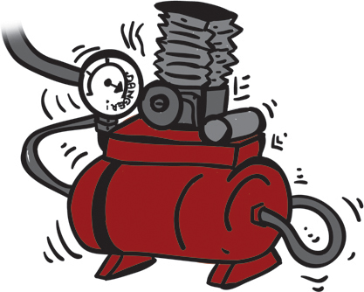
D4a: Failure Analysis: what went wrong
The difference is important because the causes for each are different…
And that means the solutions must be different.
Failure Analysis ensures that you solve the right problem.
You’re walking through your factory and you see a puddle of oil on the ground.
It might be that some oil spilled while it was being taken to disposal…
Or it could be coming from the compressor sitting in the corner

Slide 12

Only after you know what went wrong, are you ready to ask why--Root Cause Analysis
Different failures have different root causes and lead to different CAPAs and Countermeasures.
Trust the process & don’t “pre-decide”!
No tray to contain spills
No funnel used to fill oil
Seal is missing
Seal is worn out
Run at too high pressure
Overfilled
Hose not clamped properly
Hose nicked
No handle on pail
No cover on pail
Cover not sealed
Carried not level
Too heavy to carry easily
No disposal can where needed (so had to carry)
Didn’t notice (spilled but didn’t clean up)
Covering pails all day long won’t stop a leak from a broken seal.
Common sense says fix the seal anyway—that’s a JDI (Just Do It).

Slide 13



Failure Analysis prevents treating Symptoms (versus getting to and eliminating the problem)
A power plant alarm system had a high number of false alarms (125 per day). A team was asked to find out why & correct it. (An acceptable number of false alarms was considered 25/day)
The team interviewed security & was told that most of the alarms were triggered by raccoons. We decided to gather data about the different types of animals triggering alarms.
76% of alarms were indeed racoons…. “aha!” we thought, “the root cause!”
We recommended setting raccoon traps and soon caught more than 120 raccoons. The false alarms fell quickly to less than 30 per day…
2 weeks later the false alarms were back up to more than 100 per day.
On investigation, the team found a small garbage dump outside the kitchen--the sealable waste cart was gone and the food scraps were on the ground and the racoons were predictably coming for the food scraps. Trapping them was treating the symptom and not asking “what is causing the raccoons to enter the plant (when eliminated the false alarms went below 10 & stayed there…)
Tree rat
racoon
bird

Slide 14

D4a: Possible Root Causes
Especially in a Manufacturing environment, performing separate 5-Why exercise on the below is a best practice (and easier than leaving them mixed together):
Occurrence: Why did the problem occur?
(lack of) Detection: Why wasn’t it spotted (through inspection) and filtered out before shipping to NG?
Systems: What’s missing from your Quality Management System and Operating System that allowed this problem to occur?
A failure in each of these is necessary for an incident or problem to have gotten out to us.
3 is not a magic number-other failures might have also been necessary.

Slide 15
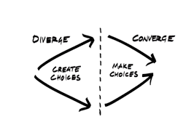


D4b: Root Cause Analysis (RCA): why did the failure(s) in D4a occur?
RCA is done in two phases:
An opening phase where you come up with possible root causes, and
A closing phase where the most likely possibilities are tested to either prove (confirm) or disprove them with data.
There are two tools commonly used in the opening phase:
5-Why analysis (consider using the 2X5 or 3X5 Why variations shown in a future slide)
Fishbone Diagram (or Ishikawa)
Either works, if you show both, you must explain how they are related.

Slide 16
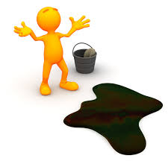
D4b: Example 5 Why and how to evaluate it
An employee slipped and fell in the factory
Prove it!
Walk the 5-Why’s backwards saying “because” or “causes”
Look for branches (contribute to or allow, but don’t cause)
If you get too many, use a fishbone (or failure tree) to organize
Don’t include 5-why and fishbones with the same information!
D4a
1. Why? – There was oil on the floor.
2. Why? – The machine in that cell was leaking oil.
3. Why? – A pressure fitting on the machine failed.
4. Why? – Inspection of hoses and fittings is not part of the preventive maintenance (PM) schedule.
5. Why? – The PM system does not consider Equipment Manufacturer’s recommendations to develop PM schedules.
6. Why?- There’s no requirement to do so.
Don’t stop with “Because we don’t have enough people, money, time…” – those are facts of life.
Solve the problem with the people, money, time you DO HAVE.
Notes:
16

Slide 17
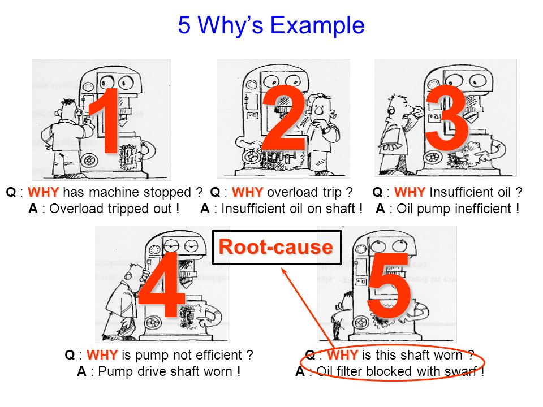
D4b: 3 X 5 why’s
5 why: Occurrence: why did the problem occur?
2X5 why: occurrence + (lack of) detection
Why did the problem occur?
Why didn’t we spot the risk before the problem occurred?
3X5 why: occurrence + (lack of) detection + systems
Why did the problem occur?
Why didn’t we spot it & prevent it?
What’s wrong with our systems that this could even happen?
Separating the thought process adds focus your problem solving.

Slide 18
3rd branch of 3x5 Why or big bone: Systems Root Cause Introduction
Systems Root Causes may be new to you—it traces the defect back to weakness in the Quality Management System or other Management Systems and includes Management behavior and accountability. These failures are often traceable to or controlled by (caused by) Support Functions, Policies & Procedures.
Some Possible Root Causes
Previous lessons not learned or put into practice.
Inadequate Reach-Across
Action Plans incomplete (lack of _____ by Accountable Sponsor).
Wrong determination of priorities (when there is conflict)
Previous CAPA’s no longer present
Ineffective way of doing things
Poorly implemented way of doing things
Focus on Product to the neglect of Process
No consequences for not following SOP
Poorly written Standard Work
Issue not covered in Work
Excess dependence on Standard Work
Guidance/policy not in one place
No guidance/policy available
Didn’t use available guidance in decision making
Mis- or non-application of general rule to a specific instance
Lack of risk-based thinking (or management)
Typical Starting Questions
Why did our system allow the incident to occur?
What was the breakdown or weakness?
Why did the possibility exist for this to occur?
Have we experienced this (or something like this) before?
Could we have imagined this happening?
What would the Executive guidance have been?
This is by far the hardest 3X5 Why Branch

Slide 19
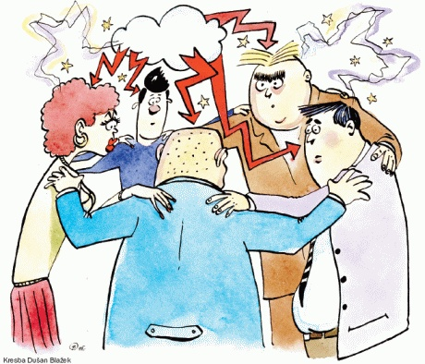
D4b: Generating Possible Root Causes: Brainstorming
The most common technique for generating ideas (possible root causes, potential interim corrective or permanent actions…) is brainstorming
2 Variations of Brainstorming Popcorn: when the sprit moves them Structured: take turns
Structured Brainstorming works well remotely; for people who think deeply about their possible input or are not extroverts (some Engineers?)
Afterwards, it might help to determine priority of ideas and/or rank them
Multi-voting
N/3: with n ideas on the board, each person votes for n/3 choices
“spend a buck” where you get 100 votes to spend how you want
Generate a list of ideas
Add value by ordering the ideas
19
Notes:
A great method is to use post its with the group to post their ideas on the board.
For some that are shy or may feel intimidated by others they can work anonymous in the Brainstorming session.
19

Slide 20
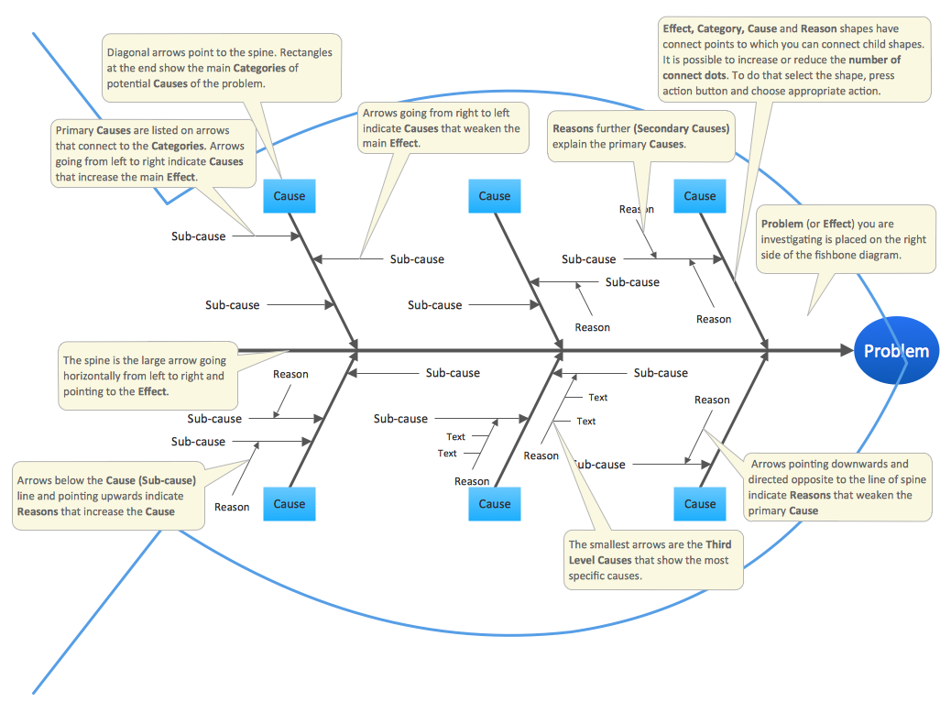
D4b: Fishbones diagrams show complex multi-level thinking
20
As you go from spine to big bone to little bone, continue to ask WHY? Examples of “big bones” are discussed on the next slide.
Notes:
The Problem is the EFFECT.
20

Slide 21

D4b: You are not restricted to MMMME as ‘bones’
Traditional Big Bones: Man, Machine, Method, Material, Environment You can do better… (customize to something that serves your problem solving rather than restricting it… example: it is a waste of time to worry about what bone an idea goes on.)
Examples:
For Manufacturing (M’s):
Man,
Materials,
Machine,
Methods,
Measurements,
Mother Nature (Environment) Maintenance
Management
Money
For Service or Transactional problems consider (P’s):
People,
Process,
(Com)Puters
Policy &
Procedures.
Environments.
For Safety (R’s):
Existence of risk
Exposure to the risk
Communication of risk
Lack of Risk Mitigation
Response to Exposure
Process oriented approach: Do a high level process map of the suspect process and use each process step as a Big Bone.
Notes:
We refer to these as the 4 M’s.
21

Slide 22
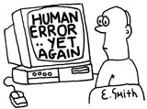
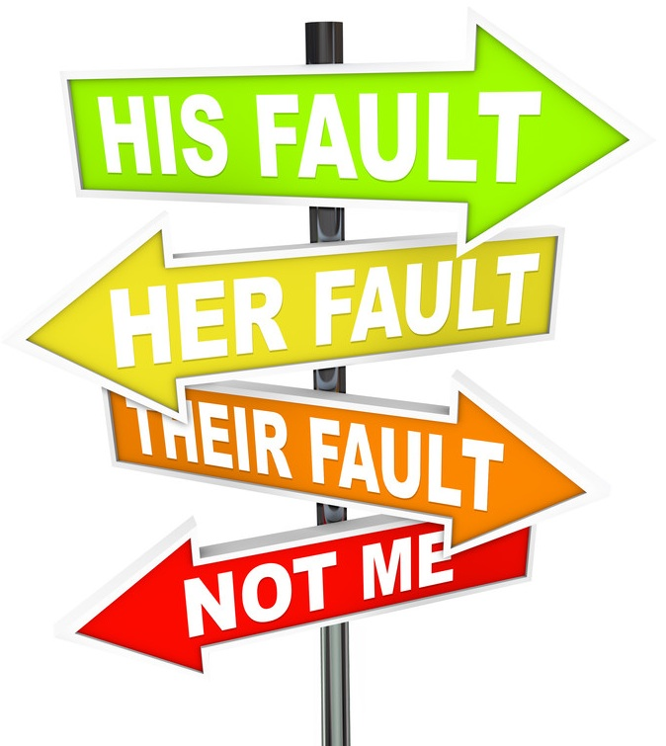
D4b Tip: Beware of “Root cause was ‘Human Error’”
HUMAN ERROR is not an acceptable root cause
How should we approach human error?
Don’t be resigned to human errors. Don’t accept:
Defects are inevitable, some are bound to escape
People make mistakes / Blame it on the person
It’s OK, we’ll detect at final inspection
Depending on or blaming errors on Sampling inspection
Think Positive
Defects can be eliminated
The more you find the better you’ll be (as you eliminate them)!
Create a mistake-proof environment by focusing on the process
Risk based thinking tool: PFMEA (don’t go overboard)
Apply Mistake-Proofing concepts (following page)
Notes:
22

Slide 23
D4c: Root Cause Confirmation
In D4a you have found at least one Error in your process (‘a WHAT’)… from D4b, you have at least one potential root cause (‘a HOW’), and now we will prove if it is ‘a valid WHY” or not.
To do this requires a definition of root cause
Let’s look at how a Possible Root Cause (from D4b) might relate to the defect/problem.
In the 2X2 chart on the right:
Columns: PRC Present & Not Present
Rows: Defect Present & Not Present
If our possible root cause is a True (or valid) root cause and we take some data & chart it, in which quadrant will most of the data be?
Possible Root Cause
Present
Not Present
Present
Defect
Not Present
Confirming the root cause makes sure you solve the right problem and don’t just do things that make sense (and hope you got the right one)

Slide 24
D4c: Root Cause Confirmation
This is for discrete data (counting data)… variables data follows
If we are testing a Valid Root Cause, then the data will be on the diagonal.
That gives us a definition. A valid root cause is something that:
when the RC is present, the defect is present AND
When the RC is absent the defect is absent.
“Most of” the data is sufficient for this test
Possible Root Cause
Present
Not Present
Present
Defect
X
Not Present
x
x
x
7
1
x
x
x
X
X
3
11
x
x
x
x
x
x
x
x
Much more useful than “I can’t define it but I know it when I see it” (Justice William Rehnquist)

Slide 25


D4c: Implications of the definition
Discrete data (counting data)
You need data from all four quadrants
That means you have to look at some cases where the defect is not present, and
You also have to look at some cases where the possible root cause is not present.
It tells you that if you can turn the Possible Root Cause OFF, then you can turn the defect off.
Your corrective action should focus on turning the Possible Root Cause off…
Turn the root cause off
Possible Root Cause
ON
OFF
X
Present
The defect turns off
Defect
Not Present
X
Turn the root cause off to turn the defect off!

Slide 26
D4c: Continuous Data
Possible Root Cause
Variable or Continuous Data (Measurements)
More of
Less of
x
x
How does this work for Continuous (Measured) Data?
Plot the data in a scatterplot
Find & plot (x-bar, y-bar), even works with medians
Draw Axes
Count the number of points in each quadrant
You can also use the adjusted R² from a regression analysis
More of
x
x
x
x
Defect
x
x
x
x
x
Less of
x
x
x
x
x
x
More of
Less of
x
x
More of
x
x
x
Defect
x
x
x
x
x
Less of
x
x
x
x
x
x
x
More of
Less of
x
x
5.5
2
More of
x
x
x
Defect
x
x
x
x
x
Less of
3.5
x
x
6.5
x
x
x
x
x

Slide 27
D4c: Root Cause Confirmed!
Now you have proof that you can control the defect by controlling the root cause… how will you use that knowledge?
You’ve unlocked the real power of RCA—you don’t have to know the countermeasures when you begin.
Figuring out Corrective Actions is as easy as figuring out how to turn on & off the Possible Root Cause. But it might not be… (stay tuned!)
Possible Root Cause
Present
Not Present
Present
Defect
X
Not Present
The roadmap for improvement comes from the definition.

Slide 28
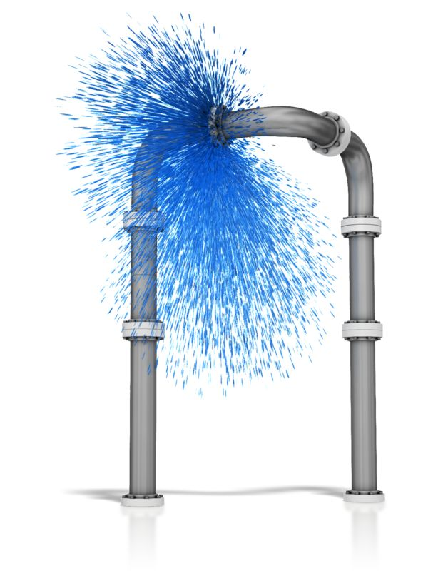
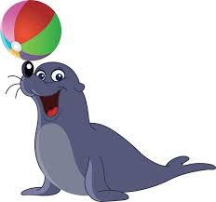

D5: Proposed Solutions
A proposed solution is WHAT you want to do as a countermeasure against a verified or proven root cause.
If a failed seal is your proven root cause, proposed solutions could include:
Eliminate the need for a seal
Repair the seal
Replace the seal
Add a redundant seal
Make the “leaking liquid” very obvious

Slide 29

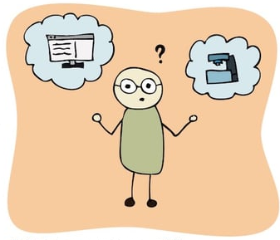
D5: Practical Methods
A practical method is how you will address the proposed solution
Eliminate the need for a seal by:
eliminate the joint or
make the joint rigid
Repair/replace the seal:
our PM team or a contractor or the OEM
Add a redundant seal:
do it ourselves or
have the ODM do it
Make the “leaking liquid” very obvious:
stinky,
bright colored,
“glow in the dark”
Proposed Solution
Practical Methods

Slide 30


D5: Choose practical methods (the Delphi Rating)
Effectiveness X Feasibility X Cost = Overall
The Overall scores inform an Action Plan.
Points to be considered:
Which root causes are you taking action against?
In what order?
Are you going to do some easy things first?
Are some of the solutions & methods “Just-Do-It’s”?
You are not bound by the overall scores—use them to get Team Consensus.

Slide 31

Delphi Ratings: how to roll your own making opinions look quantitative
Steps to create your own:
Select the attributes you want to measure
For CAPA’s, you might use: Likelihood of success, Cheapness of solution, Speed (note that 10 must be “best” and not highest)
Three is not a magic number—you could add “no customer approval required” or “less scrap” or “no customer notice required” etc.)
(Note that FMEA’s use 3 scores: Severity, Occurrence & Detectability)
Some people like to use a “1-3-9” scale versus 1-10 (then you only have to pick from: a little, medium or a lot)
You can also choose to have different components have different max scores
Be creative (use the tool to generate insight & consensus.
Using this in a Team environment
Always do the ranking & then check for consensus
We only need to agree on actions not every single value in the table
Don’t hesitate to add the groups thoughts to the results of the ranking to get an action plan
But, don’t just do what somebody told you to (as an action plan).
If the Team doesn’t agree about a particular value, do the ranking both ways and see if your decision changes.

Slide 32
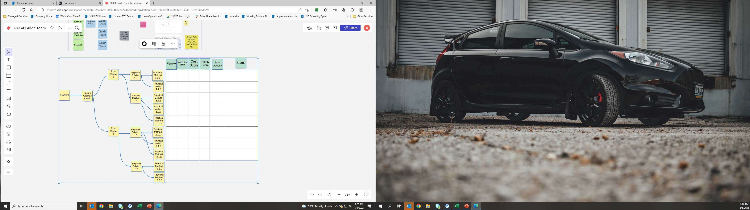
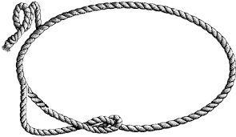
D5: Bring your readers with you: The Solutions Selection Matrix
The Solution Selection Matrix is both a map and an excellent summary tool. It shows your progress from the PROBLEM to ROOT CAUSE(S) and countermeasures and can even include Status. A kind of BLUF with detail?
Tying things
together…
Tie your work together to show its logic—stakeholders & funders appreciate it. show things you considered to build confidence.
Notes:
32

Slide 33


D6: Evaluate Results
What is there to evaluate?
The Countermeasures themselves:
Were we countermeasures successful? How do you know?
Were any further improvements called for?
Did they get made?
How the Countermeasures were implemented
(You’re going to have to implement across other shifts, cells, machines, maybe even factories)
Did we have adequate training materials & work aids?
How did you know they were complete and easy to understand and to use?
Any unintended consequences?
Overall, what did you learn?

Slide 34
VOE (Verification of Effectiveness)
Based on the analysis of many repeated issues, we have learned to divide traditional VOE into:
VOI (Implementation)—Were the Corrective Actions implemented? How do you know?
VOE (Effectiveness)—Did they work as intended? How do you know?
VORa (Reach Across)—Has the learning been applied everywhere needed to prevent NG from having other problems with our products? How do you know?
VOSip (Still in Place)—According to a schedule published in the Action Plan, are the Corrective Actions still in place and working? How do you know?

Slide 35



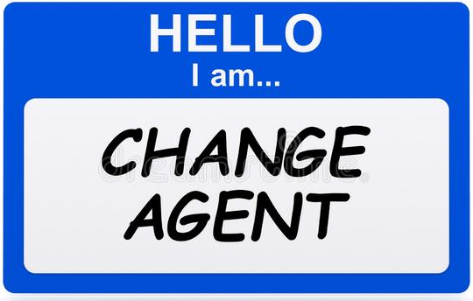
Pro-TIPs: Getting people to change (or at least, to resist change less…)
To make change easier/to get people ready, you should:
Create a shared need (why do we need to change?)
Create a shared vision (how will things be better after the change?)
Do the work of change
Make sure that the change stays in place
The only person that likes change is a wet baby
A well-executed systematic approach to change reduces resistance.

Slide 36
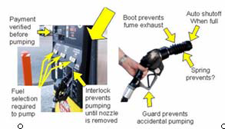

D7: Mistake-Proofing as a route to permanence
Poka-yoke is the Japanese term that means “fail-safing” or "mistake-proofing"
Examples:
Can’t start car until in park, Child-proof caps, laser curtain shut- offs for machinery
Others (look )
One of the best ways to prevent problems from occurring/recurring
Use mistake-proofing techniques when there are:
Process steps where human intervention is required
Decision points in the process
Repetitive tasks where physical manipulation of objects is required
Steps where errors are known to occur
Opportunities for predictable errors to occur

Slide 37
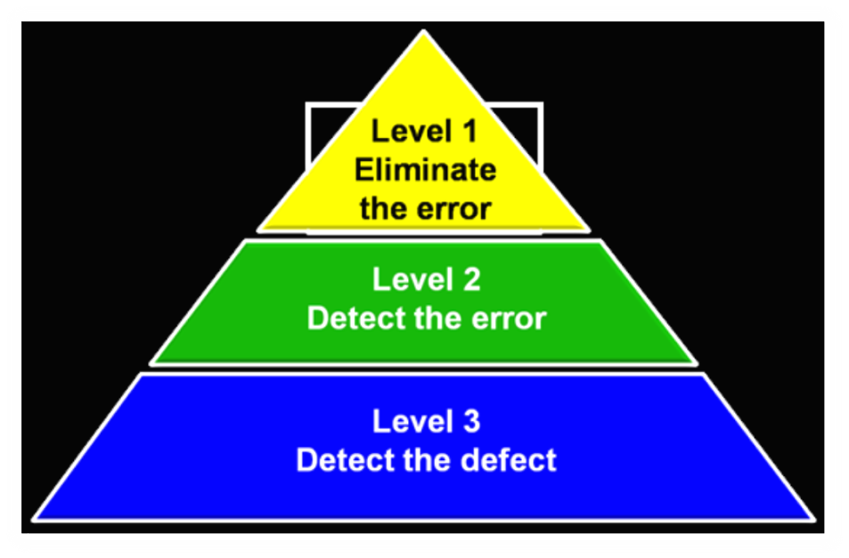
D7 Mistake-Proofing – Levels of Prevention
Eliminate the variable: Eliminate it by understanding variable interactions or by mistake proofing.
Automate the variable: Implement automated controls that require little or no manual intervention.
Control the Leading Indicators: Control the performance of the LEADING INDICATORS that drive the lagging indicator of process performance. This requires knowledge of the true leading indicators and ability to control the processes involved.
Control the Lagging Indicator: Often used in industry (i.e., 100% Inspection), but it’s too late when an incident occurs-prevention is better.
S.O.P.: This is changing the standard operating procedure implemented to detect defects. The action is not sustainable in short term or long term. (Training is HOW you change the SOP… that is why Training is neither a Root Cause nor a Corrective Action).
BEST
Design
Process
Product
WORST

Slide 38
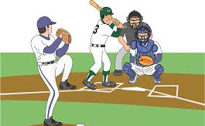

A few words about Reach Across
Reach across is:
Pitching, Catching & Umpiring
Pitching (original Team or Sponsor sends out):
The Problem
The Root Cause(s)
The Solutions
Catching (those receiving the pitch)
Do I have the same problem?
Do I have the same Root Cause(s)
What is my action Plan? (unique to my circumstances)
Umpiring (Sponsor & Management)
Did the pitchers pitch to the right places (Reach Across based on my knowledge)
Did the catchers catch?
Are the changes being made?

